Slide 1
CMS Pixel Luminosity Telescope
Test in H2B2 150 GeV/c pi- beam
Stefan Spanier
University of Tennessee, Knoxville
For the CMS – PLT collaboration

Slide 2
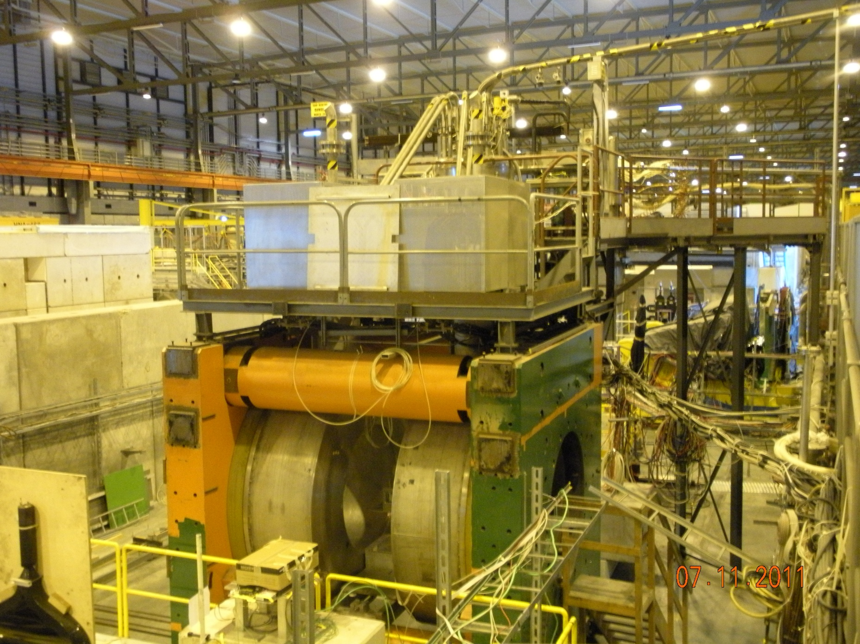
2011 Test Beam in CERN North Area
SPS Pion beam
¼ Pixel Luminosity
Telescope
3T Superconducting
Helmholtz Magnet

Slide 3
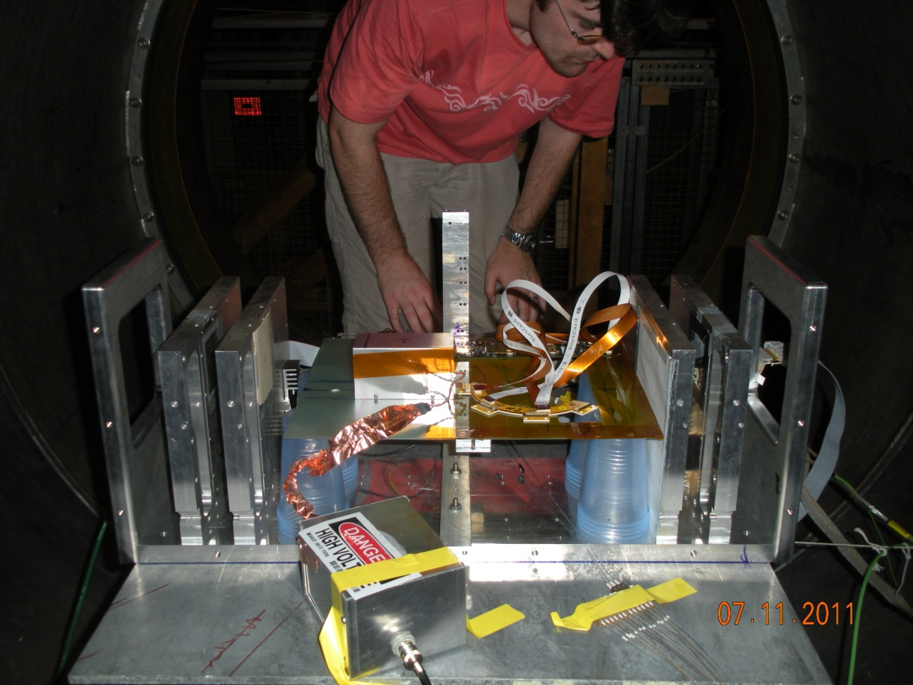
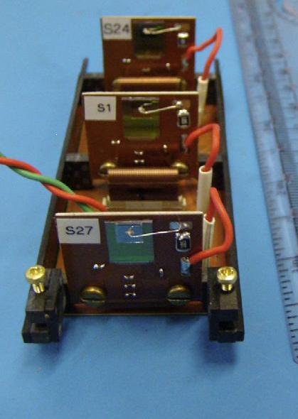
PLT-type Telescope Setup in Magnet
Matt!
Zürich Strip Telescope
2 μm track resolution
Diamond Telescope
Beam
150 GeV π
New Optical readout

Slide 4
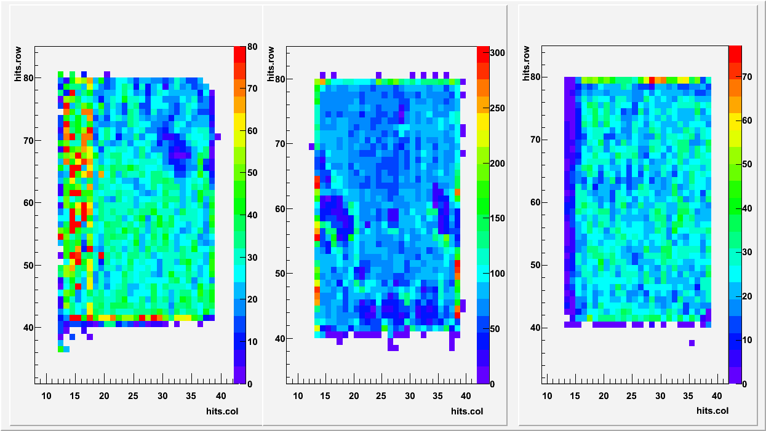
PLT Single Telescope Test
Occupancy in the 3 diamond detector planes

Slide 5
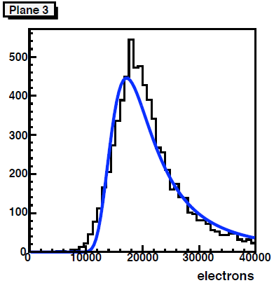
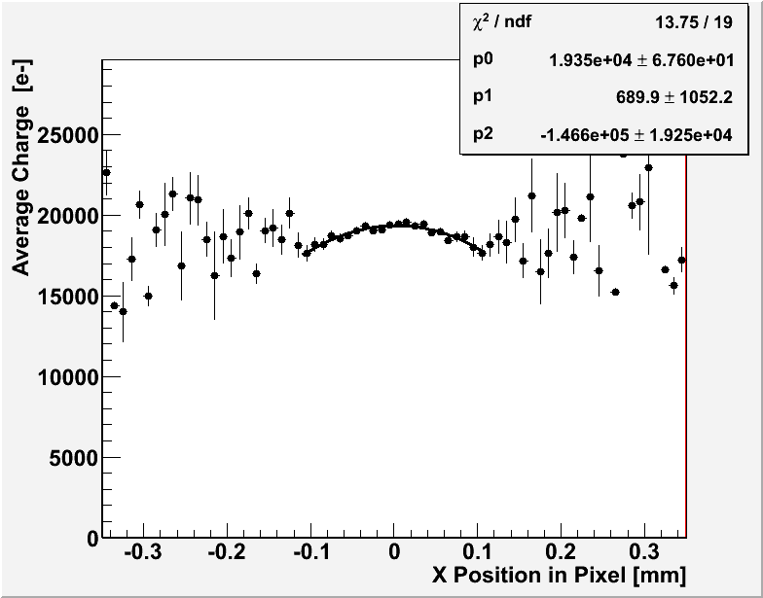
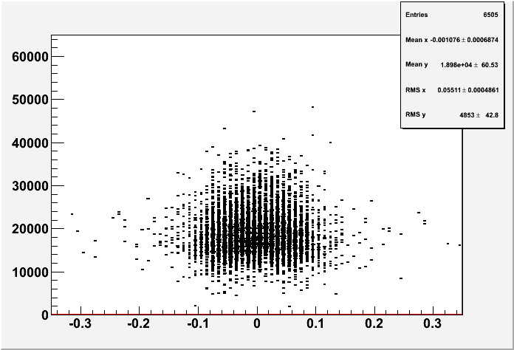
Charge deposit versus position
Threshold
Charge Deposit vs X Position in Pixel
Profile

Slide 6
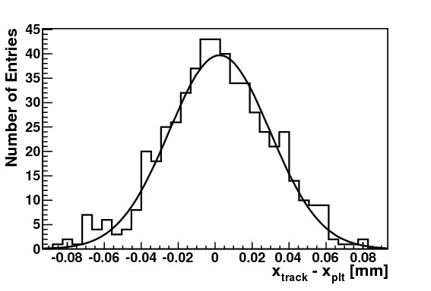
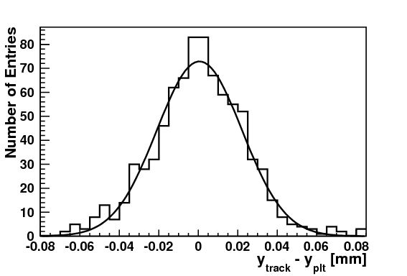
2-Hit residuals with η-based correction
Residuals: Δ_{x} = x_{track} – x_{plt} , Δ_{y} = y_{track} – y_{plt}
Required that there is exactly 1 hit in the PLT
Includes η = Q_{r}/(Q_{r}+Q_{l}) correction
Perpendicular Tracks
Entries: 588
σ: 27.33 μm (+- 1μm)
μ: 2.4 μm (+- 1.2 μm)
Entries: 823
σ: 21.6 μm (+- 0.6 μm)
μ: 0.6 μm (+- 0.8 μm)
Pixel 2010 - Matt Hollingsworth - September 4, 2010
Charge sharing improves the resolution beyond digital resolution
Efficiency goes down significantly (90% drop for perpendicular tracks) when requiring 2-hit clusters
Expected Digital Resolution
X : 43. 3 μm
Y : 28.9 μm

Slide 7

Lorentz angle/Average Mobility Measurement
150 GeV/c π⁻ from SPS
s₀
D
500 μm
B=0
θ
s₁
B>0
X
University of Tennessee
(average charge smearing)

Slide 8
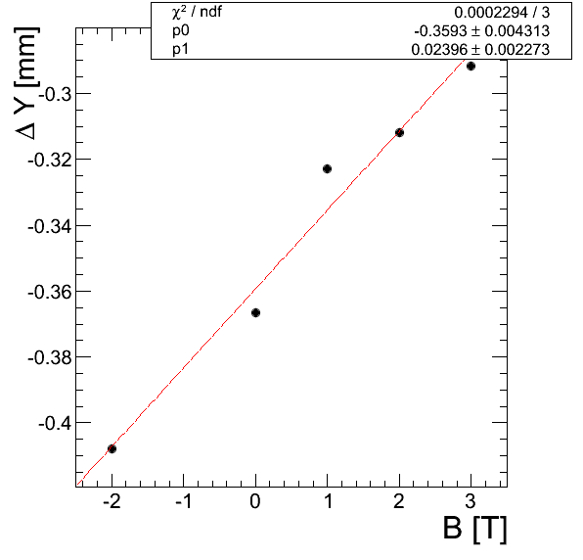
Mobility
Slope is proportional to average mobility μ
Red line is a linear fit of the data to extract slope
Find μ = 480 cm² / Vs
Compares well to findings
e.g. using transient current technique using α-source
[H.Pernegger et al. (RD42), J.App.Phys. 97 (2005) 073704]

